Slide 1
Biopharmaceutics Considerations in Drug Product Design
Prof. Dr Zafar Iqbal (TI)
Department of Pharmacy
University of Peshawar

Slide 2
Drug discovery
Drug development
Are two different process

Slide 3
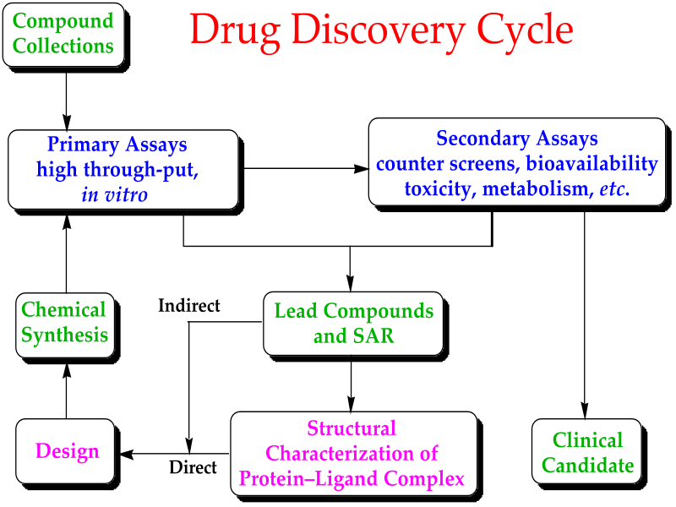

Slide 4
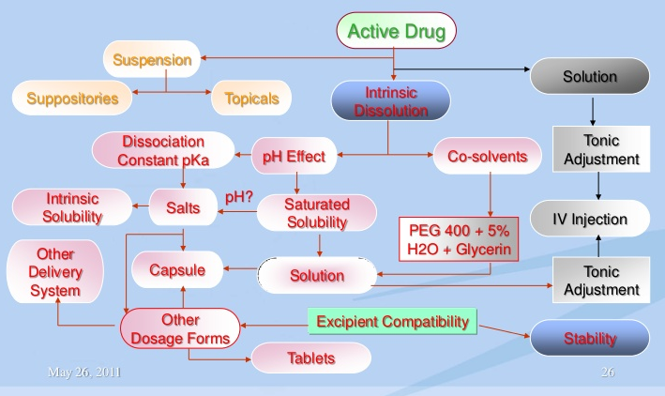

Slide 5
For a drug to exert its biological effect, it must be:
transported by the body fluids,
traverse the required biological membrane barriers,
widespread distribution,
endure metabolic attack,
penetrate in adequate concentration to the sites of action,
interact in a specific fashion,
causing an alteration of cellular function.

Slide 6
Drugs formulated into finished dosage forms (drug products), such as tablets, capsules, ointments, etc., before being administered to patients for therapy.
Formulated drug products usually include the active drug substance and excipients that make up the dosage form. Drug products are designed to deliver drug for local or systemic effects.

Slide 7
Common drug products include liquids, tablets, capsules, injectables, suppositories, transdermal systems, and topical products such as creams and ointments.
The design and formulation of drug products requires a thorough understanding of the biopharmaceutics principles of drug delivery.

Slide 8
Biopharmaceutics is the study of in-vitro impact of the physicochemical properties of drugs and drug products on drug delivery to the body under normal and or pathologic conditions. A primary concern in Biopharmaceutics is the bioavailability of drugs.

Slide 9
The aim of biopharmaceutics is to adjust the delivery of drug from the drug product in such a manner, as to provide optimal therapeutic activity and safety for the patient.

Slide 10
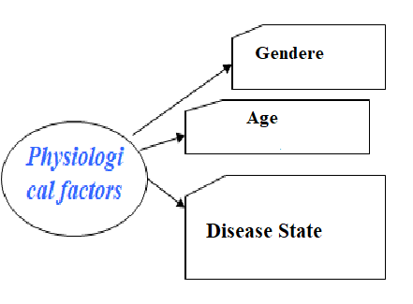
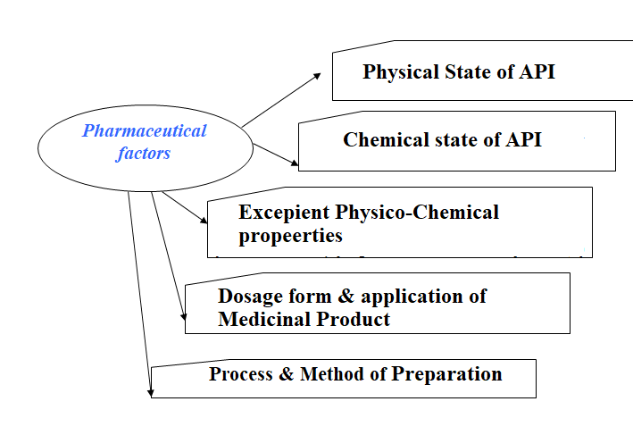

Slide 11
time of drug application
Clinical
factors
interaction simultaneously or consistently entered drugs
infringements of functions: stomach, kidneys, intimate activity, nervous system etc.
physical activity of the patient
  Biochemical factors
peculiarities of biochemical processes and
metabolism of medicinal substances for the given patient

Slide 12
Biopharmaceutics studies allow for the rational design of drug products based on:
the physical and chemical properties of the drug substance
the route of drug administration, including the anatomic and physiologic nature of the application site (e.g., oral, topical, injectable, implant, transdermal patch, etc.)
desired pharmacodynamics effect (e.g., immediate or prolonged activity)
toxicological properties of the drug,
safety of excipients
effect of excipients and dosage form on drug delivery.

Slide 13
Each route of drug application presents special Biopharmaceutics considerations in drug product design.
For example, An eye medication may require special biopharmaceutic considerations like appropriate pH, isotonicity, sterility, local irritation to the cornea, draining by tears, and concern for systemic drug absorption.

Slide 14
For a drug administered e.g., intramuscular injection, local irritation, drug dissolution, and drug absorption from the intramuscular site are some of the factors that must be considered in designing the formulation.

Slide 15
By choosing the route of drug administration carefully and properly designing the drug product, the bioavailability of the active drug can be varied from rapid and complete absorption to a slow, sustained rate of absorption.

Slide 16
Biopharmaceutics considerations often determine the ultimate dose and dosage form of a drug product. For example, the dosage for a drug intended for local activity, such as a topical drug product (e.g., ointment), is often expressed in concentration or as percentage of the active drug in the formulation (like 0.5% hydrocortisone ointment).
The amount of drug applied is not specified because the concentration of the drug at the active site relates to the pharmacodynamics action.

Slide 17
Rate-Limiting Steps in Drug Absorption
Systemic drug absorption from a drug product consists of a succession of rate processes. For solid oral, immediate-release drug products (e.g., tablets, capsules), the rate processes include:
disintegration of the drug product and subsequent release of the drug
dissolution of the drug in an aqueous environment
absorption across cell membranes into the systemic circulation.

Slide 18
In the process of drug disintegration, dissolution, and absorption, the rate at which drug reaches the circulatory system is determined by the slowest step in the sequence.
The slowest step in a series of kinetic processes is called the rate-limiting step.
For drugs that have very poor aqueous solubility, the rate at which the drug dissolves (dissolution) is often the slowest step and therefore exerts a rate-limiting effect on drug bioavailability.

Slide 19
In contrast, for a drug that has a high aqueous solubility, the dissolution rate is rapid, and the rate at which the drug crosses or permeates cell membranes is the slowest or rate-limiting step.

Slide 20
Rate processes of drug bioavailability.
Pharmaceutics Factors Affecting Drug Bioavailability
Considerations in the design of a drug product that will deliver active drug with the desired bioavailability characteristics include:
the type of drug product (e.g., solution, suspension, suppository)
the nature of the excipients in the drug product.
the physicochemical properties of the drug molecule
the route of drug administration.

Slide 21
Disintegration
For immediate-release, solid oral dosage forms, the drug product must disintegrate into small particles and release the drug. To monitor uniform tablet disintegration, the USP, B.P. etc. has established an official disintegration test.
Solid drug products exempted from disintegration tests include troches, tablets that are intended to be chewed, and drug products intended for sustained release or prolonged or repeat action.

Slide 22
Dissolution and Solubility
Dissolution is the process by which a solid drug substance dissolved in a solvent. Solubility is the mass of solute that dissolves in a specific mass or volume of solvent at a given temperature (e.g., 1 g of NaCl dissolves in 2.786 mL of water at 25°C).
Solubility is a static property; whereas dissolution is a dynamic property. In biologic systems, drug dissolution in an aqueous medium is an important prior condition for systemic absorption.

Slide 23
According to Noyes and Whitney the steps in dissolution include the process of drug dissolution at the surface of the solid particle, thus forming a saturated solution around the particle.
The dissolved drug in the saturated solution, known as the stagnant layer, diffuses to the bulk of the solvent from regions of high drug concentration to regions of low drug concentration.

Slide 24
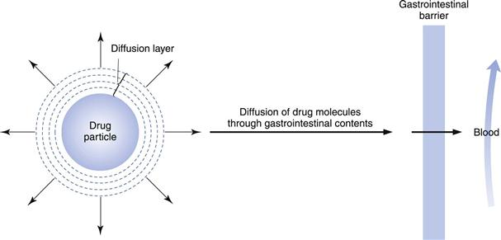

Slide 25
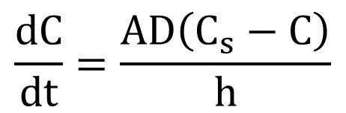
$$\frac{dC}{dt}=\frac{AD\left(C_{s}−C\right)}{h}$$
where dC/dt = rate of drug dissolution at time t, D = diffusion rate constant, A = surface area of the particle, C_{S} = concentration of drug (equal to solubility of drug) in the stagnant layer, C = concentration of drug in the bulk solvent, and h = thickness of the stagnant layer. The rate of dissolution, dC/dt, is the rate of drug dissolved per unit time expressed as concentration change in the dissolution fluid.

Slide 26
Dissolution in a flask may be influenced by the physicochemical characteristics of the drug, the formulation, and the solvent.
Drug in the body, particularly in the gastrointestinal tract, is considered to be dissolving in an aqueous environment.
Permeation of drug across the gut wall (a model lipid membrane) is affected by the ability of the drug to diffuse (D) and to partition between the lipid membrane.

Slide 27
In addition to these factors, the temperature of the medium and the agitation rate also affect the rate of drug dissolution.
In vivo, the temperature is maintained at a constant 37°C, and the agitation (primarily peristaltic movements in the gastrointestinal tract) is reasonably constant.
In contrast, in-vitro studies of dissolution kinetics require maintenance of constant temperature and agitation. Temperature is generally kept at 37°C, and the agitation or stirring rate is held to a specified rpm (revolutions per minute).

Slide 28
An increase in temperature will increase the kinetic energy of the molecules and increase the diffusion constant, D.
Moreover, an increase in agitation of the solvent medium will reduce the thickness, h, of the stagnant layer, allowing for more rapid drug dissolution.

Slide 29
Factors that affect drug dissolution of a solid oral dosage form include:
1. the physical and chemical nature of the active drug substance
2. the nature of the excipients,
3. the method of manufacture.

Slide 30
pK_{a} and pH profile | Necessary for optimum stability and solubility of the final product.
Particle size | May affect the solubility of the drug and therefore the dissolution rate of the product.
Polymorphism | The ability of a drug to exist in various crystal forms may change the solubility of the drug. Also, the stability of each form is important, because polymorphs may convert from one form to another.
Hygroscopicity | Moisture absorption may affect the physical structure as well as stability of the product.
Partition coefficient | May give some indication of the relative affinity of the drug for oil and water. A drug that has high affinity for oil may have poor release and dissolution from the drug product.
Excipient interaction | The compatibility of the excipients with the drug and sometimes trace elements in excipients may affect the stability of the product. It is important to have specifications of all raw materials.
pH stability profile | The stability of solutions is often affected by the pH of the vehicle; furthermore, because the pH in the stomach and gut is different, knowledge of the stability profile would help to avoid or prevent degradation of the product during storage or after administration.

Slide 31
Particle Size and Drug Absorption
The effective surface area of a drug is increased enormously by a reduction in the particle size.
Because dissolution takes place at the surface of the solute (drug), the greater the surface area, the more rapid is the rate of drug dissolution.
The geometric shape of the particle also affects the surface area, and, during dissolution, the surface is constantly changing. In dissolution calculations, the solute particle is usually assumed to have retained its geometric shape.

Slide 32
Particle size and particle size distribution studies are important for drugs that have low water solubility.
Many drugs are very active intravenously but are not very effective when given orally, because of poor oral absorption.

Slide 33
For poorly soluble drugs, a disintegrant may be added to the formulation to ensure rapid disintegration of the tablet and release of the particles.
The addition of surface-active agents may increase wetting as well as solubility of these drugs.

Slide 34
Polymorphism, Solvates, and Drug Absorption
Polymorphism refers to the arrangement of a drug substance in various crystal forms or polymorphs.
Polymorphs have the same chemical structure but different physical properties, such as solubility, density, hardness, and compression characteristics.
Some polymorphic crystals have much lower aqueous solubility than the amorphous forms, causing a product to be incompletely absorbed.

Slide 35
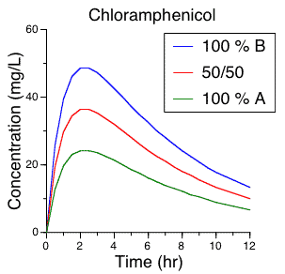
Chloramphenicol, for example, has several crystal forms, and when given orally as a suspension, the drug concentration in the body was found to be dependent on the percent of -polymorph in the suspension.

Slide 36
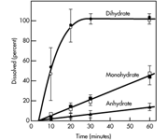
Dissolution behavior of erythromycin dihydrate, monohydrate, and anhydrate in phosphate buffer (pH 7.5) at 37°C.

Slide 37
Common Excipients Used in Solid Drug Products
Excipient | Property in Dosage Form
Lactose | Diluent
Dibasic calcium phosphate | Diluent
Starch | Disintegrant, diluent
Microcrystalline cellulose | Disintegrant, diluent
Magnesium stearate | Lubricant
Stearic acid | Lubricant
Hydrogenated vegetable oil | Lubricant
Talc | Lubricant
Sucrose (solution) | Granulating agent
Polyvinyl pyrrolidone (solution) | Granulating agent
Hydroxypropylmethylcellulose | Tablet-coating agent
Titinium dioxide | Combined with dye as colored coating
Methylcellulose | Coating or granulating agent
Cellulose acetate phthalate | Enteric coating agent

Slide 38
Common Excipients Used in Oral Liquid Drug Products
Excipient | Property in Dosage Form
Sodium carboxymethylcellulose | Suspending agent
Tragacanth | Suspending agent
Sodium alginate | Suspending agent
Xanthan gum | Thixotropic suspending agent
Veegum | Thixotropic suspending agent
Sorbitol | Sweetener
Alcohol | Solubilizing agent, preservative
Propylene glycol | Solubilizing agent
Methyl, propylparaben | Preservative
Sucrose | Sweetener
Polysorbates | Surfactant
Sesame oil | For emulsion vehicle
Corn Oil | For emulsion vehicle

Slide 39
Dissolution Apparatus (USP/Non-Official)
Apparatusª | Name | Drug Product
Apparatus 1 | Rotating basket | Tablets
Apparatus 2 | Paddle | Tablets, capsules, modified drug products, suspensions
Apparatus 3 | Reciprocating cylinder | Extended-release drug products
Apparatus 4 | Flow cell | Drug products containing low-water-soluble drugs
Apparatus 5 | Paddle over disk | Transdermal drug products
Apparatus 6 | Cylinder | Transdermal drug products
Apparatus 7 | Reciprocating disk | Extended-release drug products
Rotating bottle | (Non-USP-NF) | Extended-release drug products (beads)
Diffusion cell (Franz) | (Non-USP-NF) | Ointments, creams, transdermal drug products

Slide 40
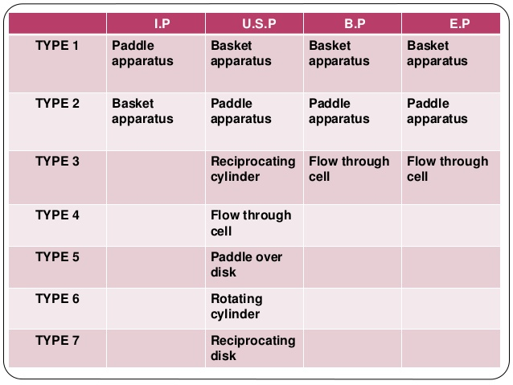

Slide 41
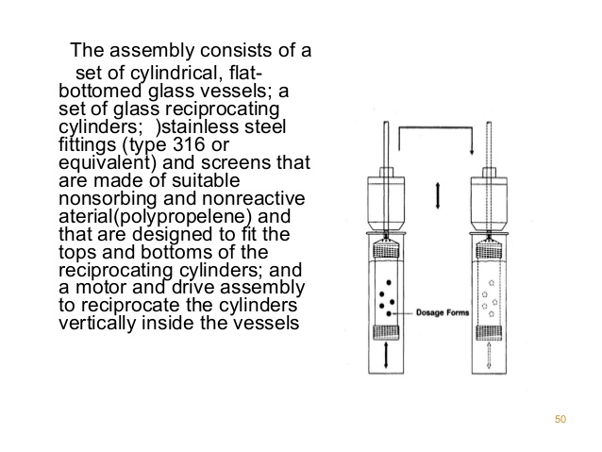

Slide 42
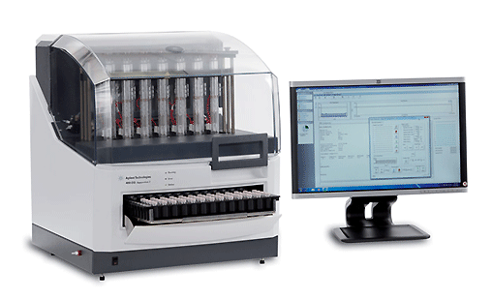

Slide 43
Dissolution Acceptance
Stage | Number Tested | Acceptance Criteria
S₁ | 6 | Each unit is not less than Q + 5%
S₂ | 6 | Average of 12 units (S₁ + S₂) is equal to or greater than Q, and no unit is less than Q – 15%
S₃ | 12 | Average of 24 units (S₁ + S₂ + S₃) is equal to or greater than Q, not more than 2 units are less than Q – 15%, and no unit is less than Q – 25%

Slide 44
The basket method is less sensitive to the tilting effect. However, the basket method is more sensitive to clogging due to gummy materials.
Pieces of small particles can also clog up the basket screen and create a local non-sink condition for dissolution.
Furthermore, dissolved gas in the medium may form air bubbles on the surface of the dosage form unit and can affect dissolution in both the basket and paddle methods.

Slide 45
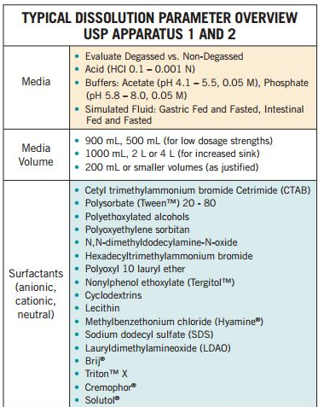

Slide 46
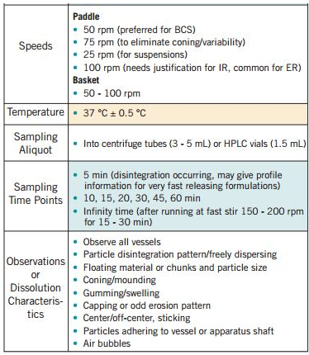

Slide 47
The use of various testing methods makes it difficult to interpret dissolution results, because there is no simple correlation among dissolution results obtained with various methods.
For many drug products, the dissolution rates are higher with the paddle method. Dissolution results at 50 rpm with the paddle method may be equivalent to dissolution at 100 rpm with the basket method.

Slide 48
In a comparison of the paddle and basket methods in evaluating a sustained-release pseudoephedrine–guaifenesin preparation, found that the paddle method was more discriminating in demonstrating dissolution differences among drug products.
At 100 rpm, the basket method failed to pick up formulation differences detected by the paddle method.

Slide 49
In the absence of in-vivo data, the selection of the dissolution method is based on the type of drug product to be tested.
For example, a low-density preparation may be poorly wetted in the basket method.
A gummy preparation may clog up the basket screen; therefore the paddle method is preferred.
For many drugs, a satisfactory dissolution test may be obtained with more than one method by optimizing the testing conditions.

Slide 50
BIOPHARMACEUTICS CLASSIFICATION SYSTEM

Slide 51
Scientific framework for classifying drug substances based on their aqueous solubility and intestinal permeability
BCS is importance in determining bioavailability of drugs

Slide 53
API structure
salt form and excipients
drug solubility
drug product quality attributes
  Bioavailability of drug
  is determined by
  extent of drug solubility
  and
  permeability

Slide 54
Guidance provided by the U.S. Food and Drug Administration for predicting the intestinal drug absorption

Slide 55
Drug development tool that allows estimation of the contributions of 3 major factors, that affect oral drug absorption from immediate release solid oral dosage forms
Dissolution
Solubility
Intestinal permeability.

Slide 56
Biopharmaceutics Classification System (BCS) is a predictive approach to relate certain physicochemical characteristics of a drug substance and drug product to in-vivo bioavailability
BCS categorized drugs according to two key physico-chemical parameters:
  Solubility
  Permeability

Slide 57
These two factors were selected because:
i. most orally administered drugs are absorbed via a passive diffusion process through the small intestine,
ii. where the extent of oral absorption is largely influenced by a drug’s membrane permeability and solubility

Slide 58
BCS Class | Solubility | Permeability | Example
Class-I | High | High | Metoprolol
Class-II | Low | High | Glebinclamide
Class-III | High | Low | Cimetidine
Class-IV | Low | Low | Hydrochlorothiazide

Slide 59
A drug substance is considered HIGHLY SOLUBLE when the highest dose strength is soluble in about 250 ml water over a pH range of 1 to 7.5.
A drug substance is considered HIGHLY PERMEABLE when the extent of absorption in humans is determined to be > 90% of an administered dose, based on mass-balance or in comparison to an intravenous reference dose.

Slide 62
The BCS is not a direct in-vitro–in-vivo correlation or alternate of IVIV correlation.
We presume that drug substance from an immediate-release oral drug product would be rapidly and mostly absorbed if the drug substance and drug product meet the criteria for BCS Class I drugs.
Since predictability is a major function of IVIVC, any system that predicts in-vivo performance from in-vitro data may be considered an IVIVC.

Slide 63
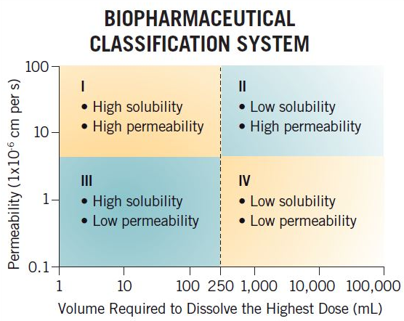

Slide 64
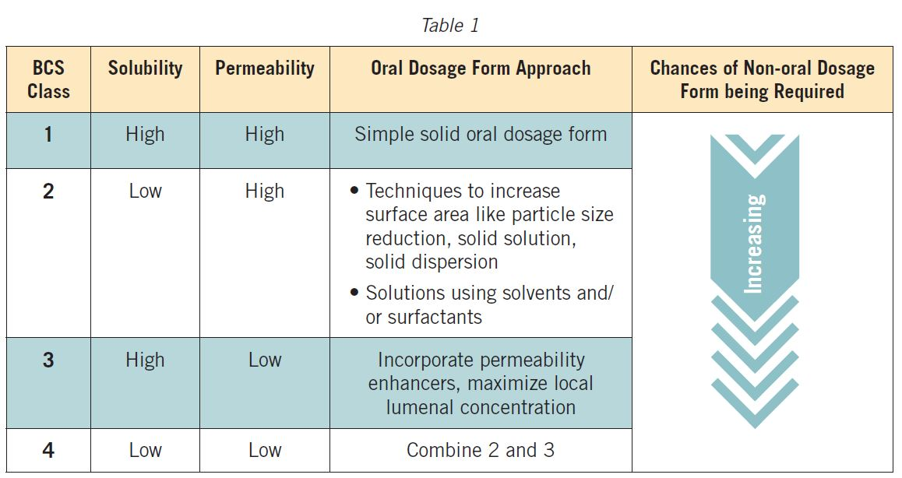
For oral drug delivery, a simplified summary of approaches based on properties might look like Table 1. Each approach must then be tailored to meet the other demands of that particular API and desired product profile.

Slide 65
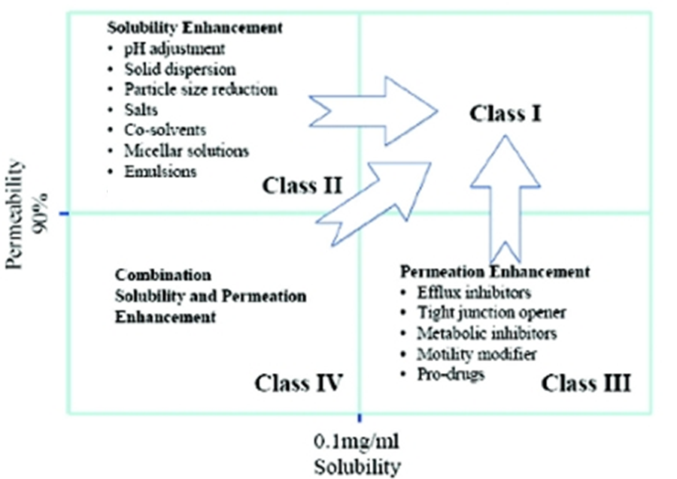

Slide 66
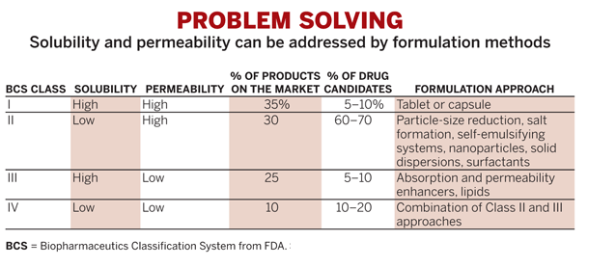

Slide 67
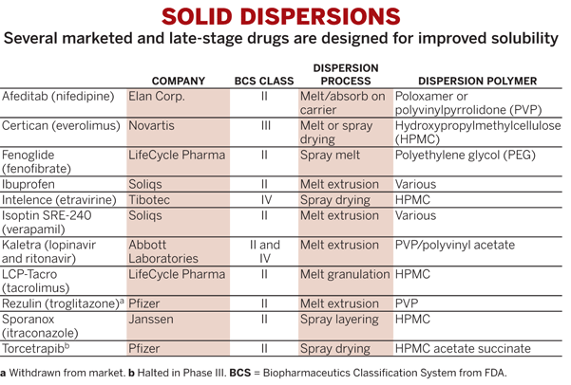

Slide 68
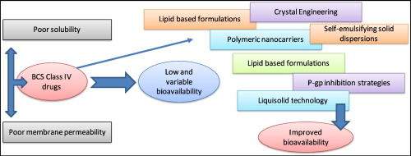

Slide 69
In-Vitro–In-Vivo Correlation
In-vitro–in-vivo correlation (IVIVC) establishes a relationship between a biological property of the drug (such as pharmacodynamic effect or plasma drug concentration) and a physicochemical property of the drug product containing the drug substance, such as dissolution rate.
In order to have an IVIVC, some property of the drug release from the drug product in vitro, under specified conditions, must relate to in-vivo drug performance.

Slide 70
The absorption time may be used in correlating dissolution data to absorption data. The absorption time refers to the time for a constant amount of drug to be absorbed.
In the analysis of in-vitro–in-vivo drug correlation, rapid drug dissolution may be distinguished from the slower drug absorption by evaluation of the absorption time for the preparation.
In one study involving three sustained-release aspirin products, the dissolution time for the preparations were linearly correlated to the absorption times. The results from this study demonstrated that aspirin was rapidly absorbed and was very much dependent on the dissolution rate for absorption.

Slide 71
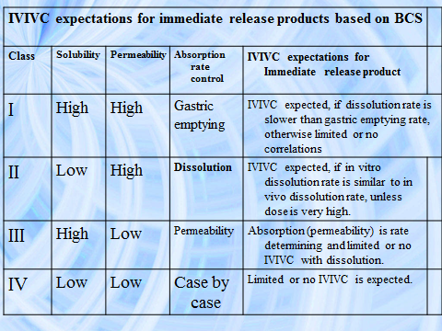

Slide 72
Biopharmaceutic Considerations in Drug Product Design
Pharmacodynamic considerations | Patient considerations
Therapeutic objective | Compliance and acceptability of drug product
Toxic effects | Cost
Adverse reactions | Manufacturing considerations
Drug considerations | Cost
Chemical and physical properties of drug | Availability of raw materials
Drug product considerations | Stability
Pharmacokinetics of drug | Quality control
Bioavailability of drug | Method of manufacturing
Route of drug administration
Desired drug dosage form
Desired dose of drug

Slide 73
The finished drug product is a compromise of various factors, including therapeutic objectives, pharmacokinetics, physical and chemical properties, manufacturing, cost, and patient acceptance.
Most important, the finished drug product should meet the therapeutic objective by delivering the drug with maximum bioavailability and minimum adverse effects.

Slide 74
Pharmacodynamic Considerations
Therapeutic considerations concern the pharmacodynamics and pharmacologic properties of the drug, including the desired therapeutic response as well as the type and frequency of toxic and/or adverse reactions of the drug.
The therapeutic objective will influence the type of drug product to be manufactured. A drug used to treat an acute illness should be formulated to release the drug rapidly, allowing for quick absorption and rapid onset.

Slide 75
Pharmacokinetics of the Drug
Knowledge of the pharmacokinetic profile of the drug is important to estimate the appropriate amount (dose) of drug in the drug product and a release rate that will maintain a desired drug level in the body.
The therapeutic window determines the desired or target plasma drug concentration that will be effective with minimal adverse effects

Slide 76
Bioavailability of the Drug
The stability of the drug in the gastrointestinal tract, including the stomach and intestine, is another consideration. Some drugs, such as penicillin G, are unstable in the acidic medium of the stomach.
The addition of buffering in the formulation or the use of an enteric coating on the dosage form will protect the drug from degradation at a low pH.
Some drugs have poor bioavailability because of first-pass effects (presystemic elimination).

Slide 77
Designing dosage forms to contain unabsorbed drug contains risk that under unusual conditions (e.g., change in diet or disease condition), complete drug absorption can occur leading to excessive drug bioavailability and toxicity.
If the drug is not absorbed after the oral route or a higher dose causes toxicity, then the drug must be given by an alternative route of administration, and a different dosage form such as a parenteral drug product might be needed.

Slide 78
Dose Considerations
The size of the dose in the drug product is based on the inherent potency of the drug and its apparent volume of distribution, which determines the target plasma drug concentration needed for the desired therapeutic effect.
For some drugs, wide variation in the size of the dose is needed for different patients because of large intersubject differences in the pharmacokinetics and bioavailability of the drug.
Therefore, the drug product must be available in several dose strengths to allow for individualized dosing.

Slide 79
Impotent Questions
1. What physical or chemical properties of a drug substance are important in designing a drug for (a) oral administration or (b) parenteral administration?
2. For a lipid-soluble drug that has very poor aqueous solubility, what strategies could be used to make this drug more bioavailable after oral administration?
3. For a weak ester drug that is unstable in highly acid or alkaline solutions, what strategies could be used to make this drug more bioavailable after oral administration?
4. How do excipients in a drug product that are physically inert, chemically inert, and nontoxic change the bioavailability of the active drug substance?

